Slide 1
Figures made using final data set

Slide 2
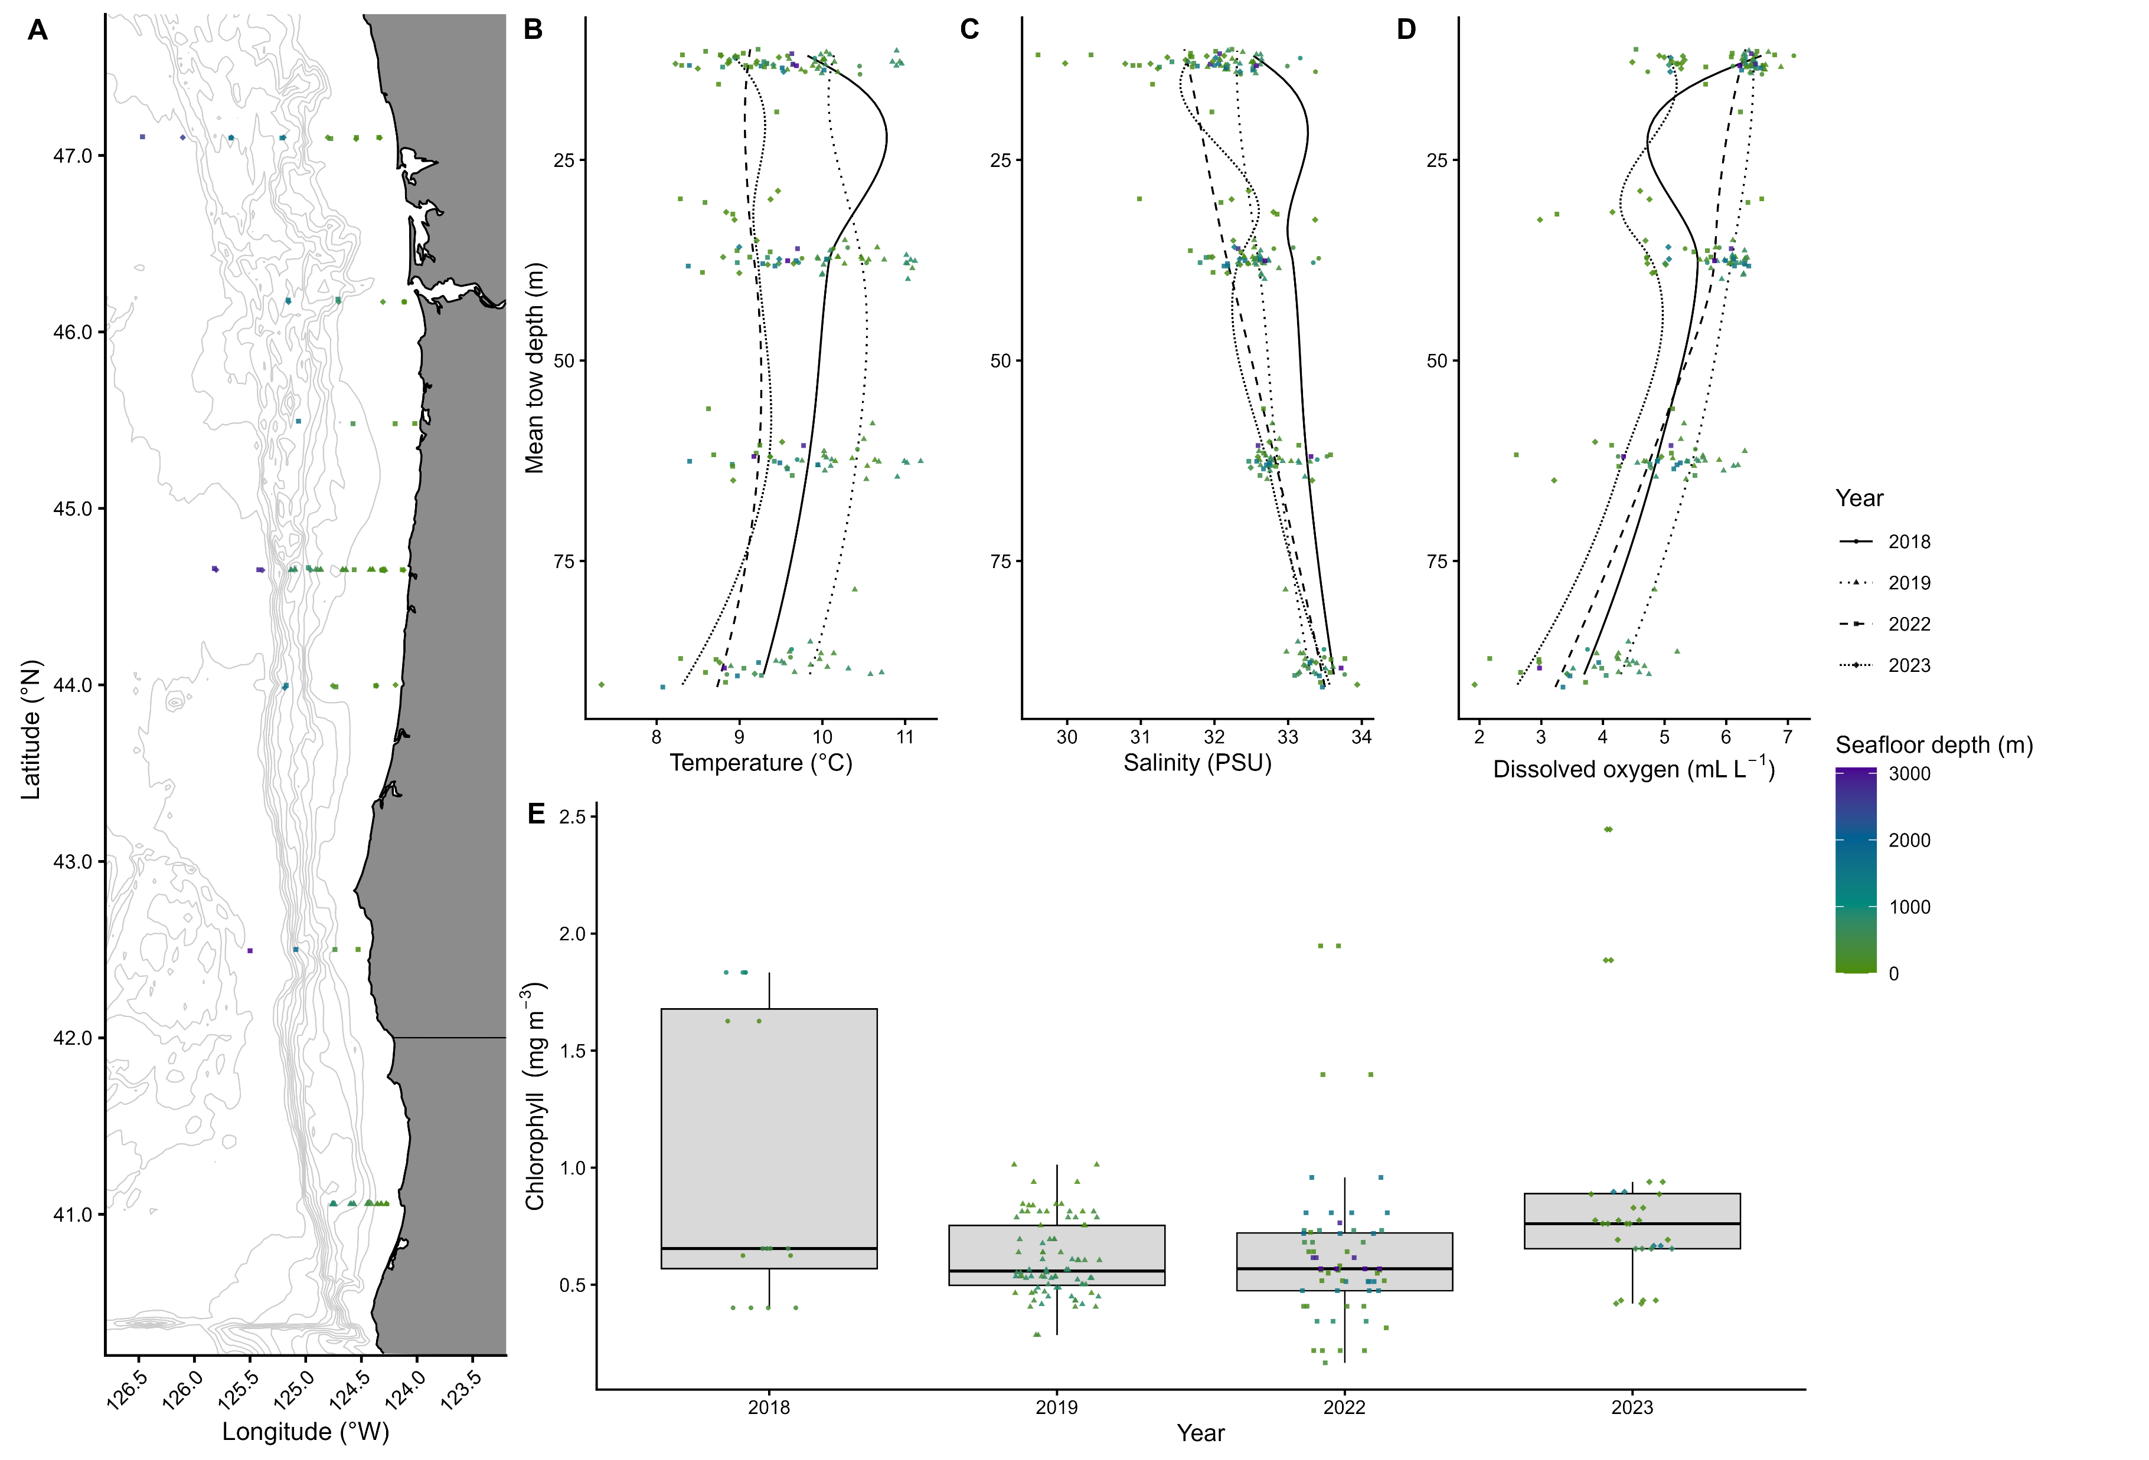
Fig. 1. Environmental conditions at each sampling station: (A) locations sampled; (B) temperature, (C) salinity, and (D) dissolved oxygen at the mean depth of each net tow, with locally weighted scatterplot smooths; and (E) mean chlorophyll-a concentration in the top 100 m of the water column in each year. Symbol shapes and line types indicate year and symbol color indicates seafloor depth. Variation in the position of points along the x-axis in (E) has been added for increased visibility.

Slide 3
Table 1. Taxa associated with each cluster as determined using indicator taxa analysis. Taxa are listed in order of summed abundance within each cluster.
Cluster | Taxa | p
1 | Sebastes spp. | 0.005
2 | Parophrys vetulus Sebastes spp. | 0.005 0.005
3 | Stenobrachius leucopsarus | 0.02
4 | Stenobrachius leucopsarus | 0.02
5 | Parophrys vetulus Liparis spp. | 0.005 0.03
6 | Osmeridae | 0.005
7 | Hexagrammidae Liparis spp. | 0.005 0.03

Slide 4
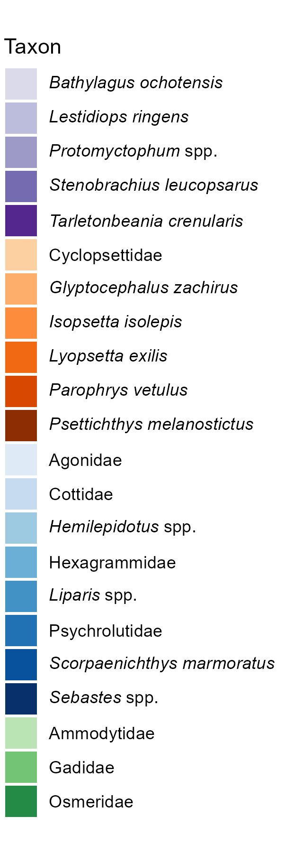
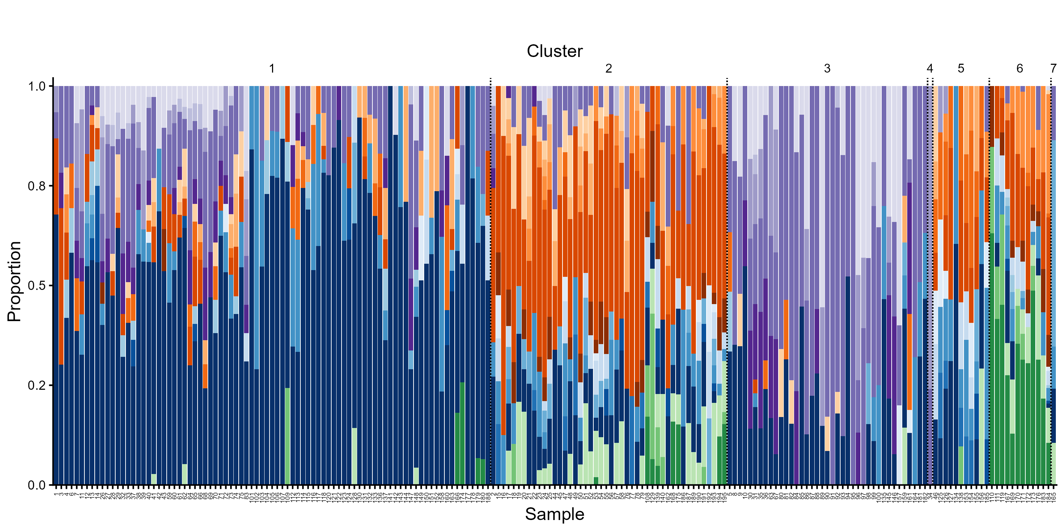
Fig. 2a. Proportion of taxa in samples assigned to each cluster. Colors correspond to coarse habitat affinity and taxonomic groups: mesopelagics (purples), Pleuronectiformes (oranges), Perciformes (blues), and other coastal taxa (greens).

Slide 5
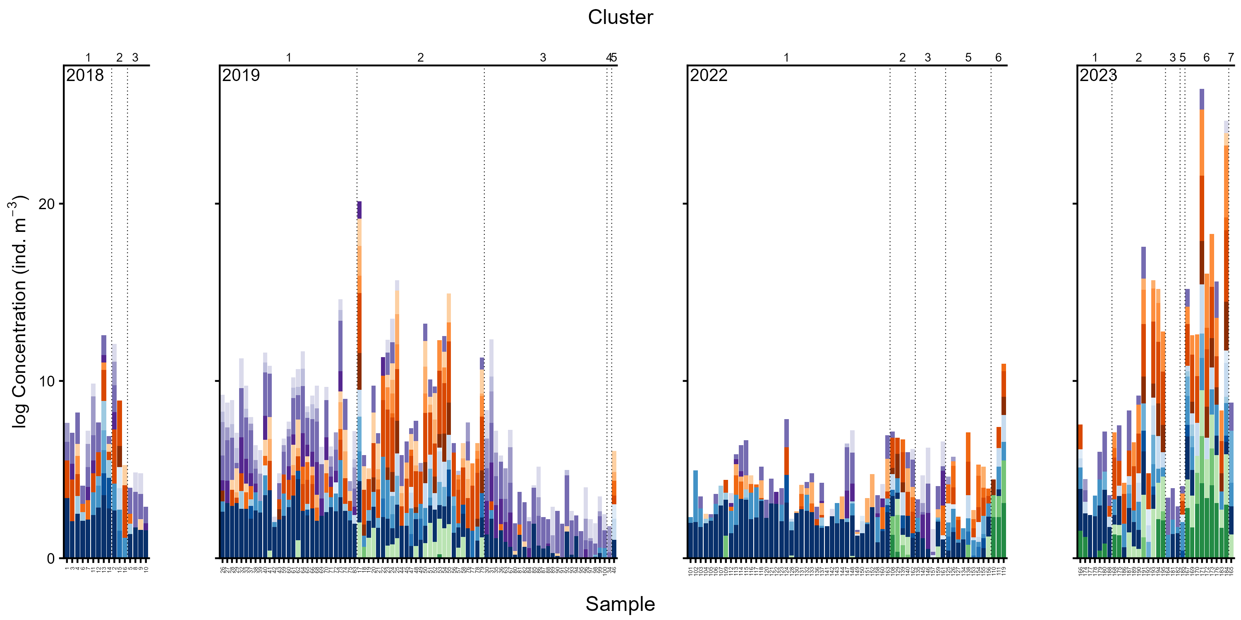
Fig. 2b. Log-transformed concentration of taxa in samples assigned to each cluster in each year.

Slide 6
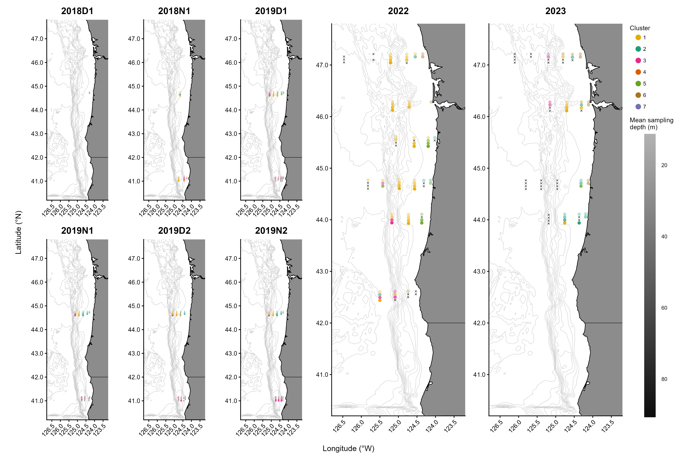
Fig. 3. Collection locations of samples assigned to each cluster, separated by sampling replicate. Panel titles indicate the year and, for 2018 and 2019, whether collection took place primarily during day (D) or night (N) and the sampling replicate number. Circle colors indicate the cluster each sample was assigned to and translucence indicates mean sampling depth of the net tow each sample was collected in. “X”s indicate net tows in which fewer than 10 fish larvae or no larvae belonging to taxa present in > 5% of net tows were collected.

Slide 7
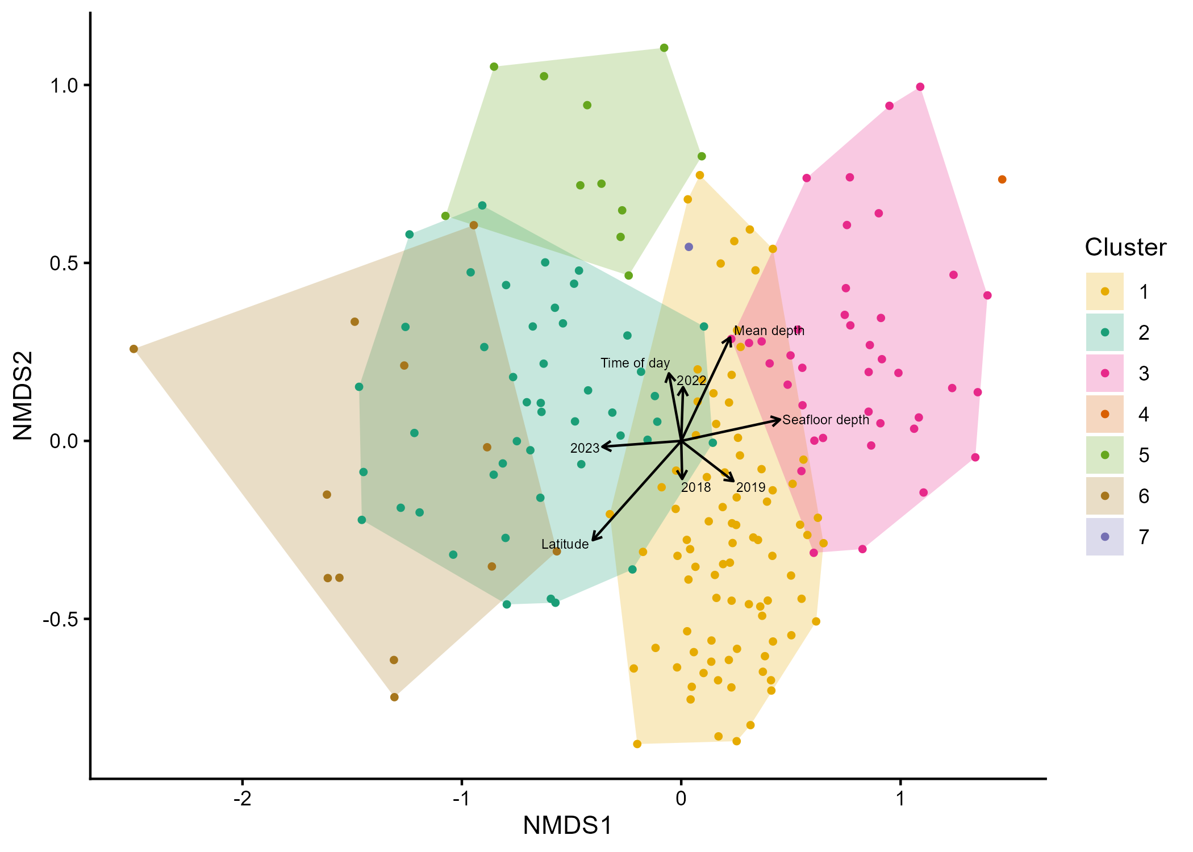
Fig. 4. NMDS ordination of larval fish samples. Points represent samples and are colored by cluster assignment. Colored polygons encompass all samples assigned to each cluster. Arrows indicate the direction of increasing values and relative strength of post hoc associations between spatiotemporal covariates and the NMDS ordination space.

Slide 8
dbRDA results (won’t be included in manuscript in table form)
dbRDA model | R² | Adj. R² | Pseudo-F | p
Spatiotemporal | 0.10 | 0.07 | 3.04 | 0.001
Spatiotemporal + environmental | 0.14 | 0.09 | 2.70 | 0.001
Model term | Df | Pseudo-F | p
Year | 3 | 1.65 | 0.001
Time of day | 1 | 1.36 | 0.027
Latitude | 1 | 2.55 | 0.001
Mean tow depth | 1 | 2.85 | 0.001
Seafloor depth | 1 | 1.95 | 0.002
Temperature | 1 | 1.55 | 0.010
Salinity | 1 | 1.78 | 0.001
Dissolved oxygen | 1 | 3.24 | 0.001
Chlorophyll | 1 | 2.41 | 0.001
Model component | Variance explained
Spatiotemporal | 0.0372
Environmental | 0.0192
Shared | 0.0157
Total | 0.0878

Slide 9
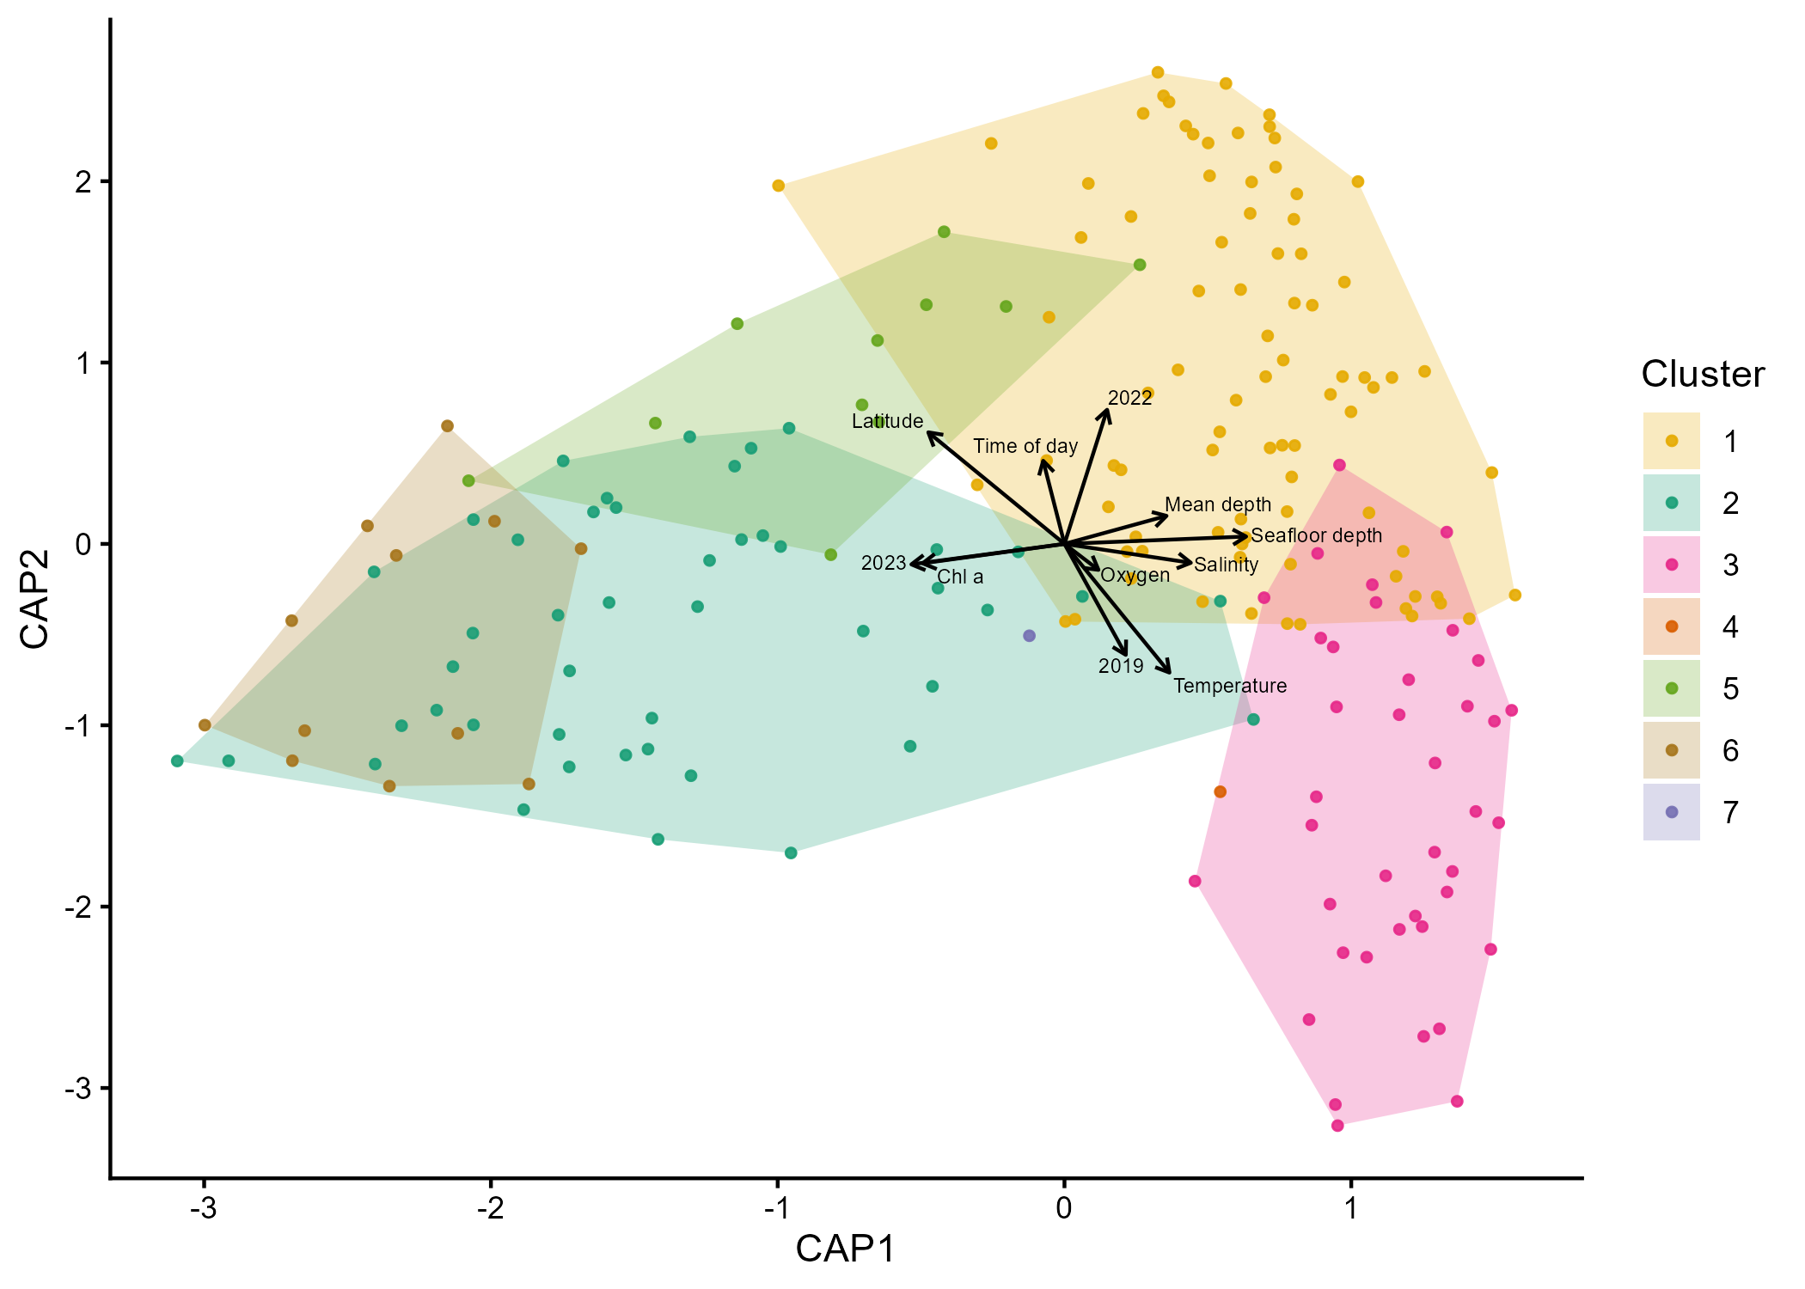
Fig. 5. dbRDA ordination of larval fish samples. Points represent samples and are colored by cluster assignment. Colored polygons encompass all samples assigned to each cluster. Arrows indicate the direction and relative strength of associations between covariates and the constrained ordination axes.

Slide 10
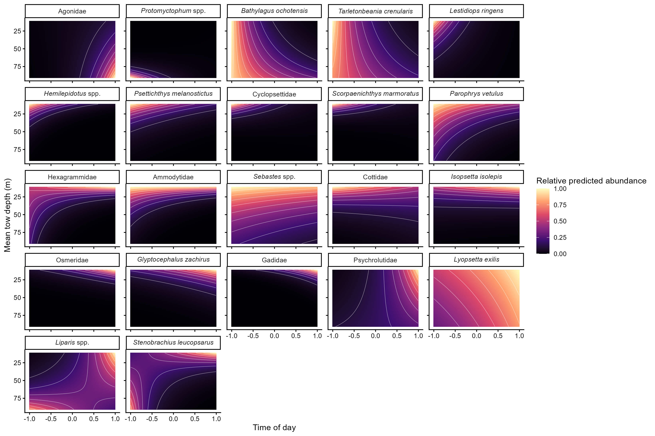
Fig. 6. Surfaces showing abundance of each taxon predicted from GLMM, normalized to the highest predicted abundance of each taxon, at combinations of depth and time of day.

Slide 11
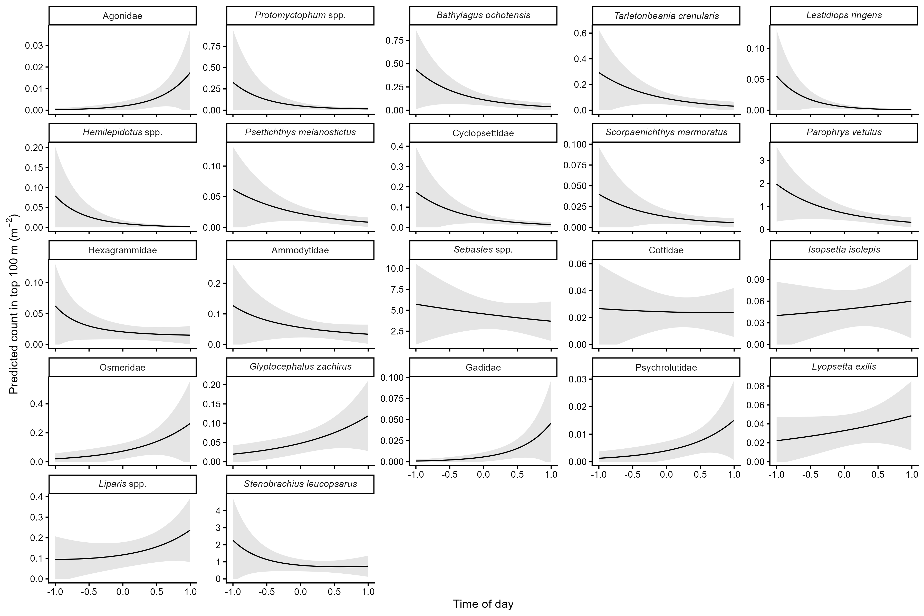
Fig. 7. Total predicted count in the top 100 m of the water column of each taxon predicted by GLMM vs. time of day.

Slide 12
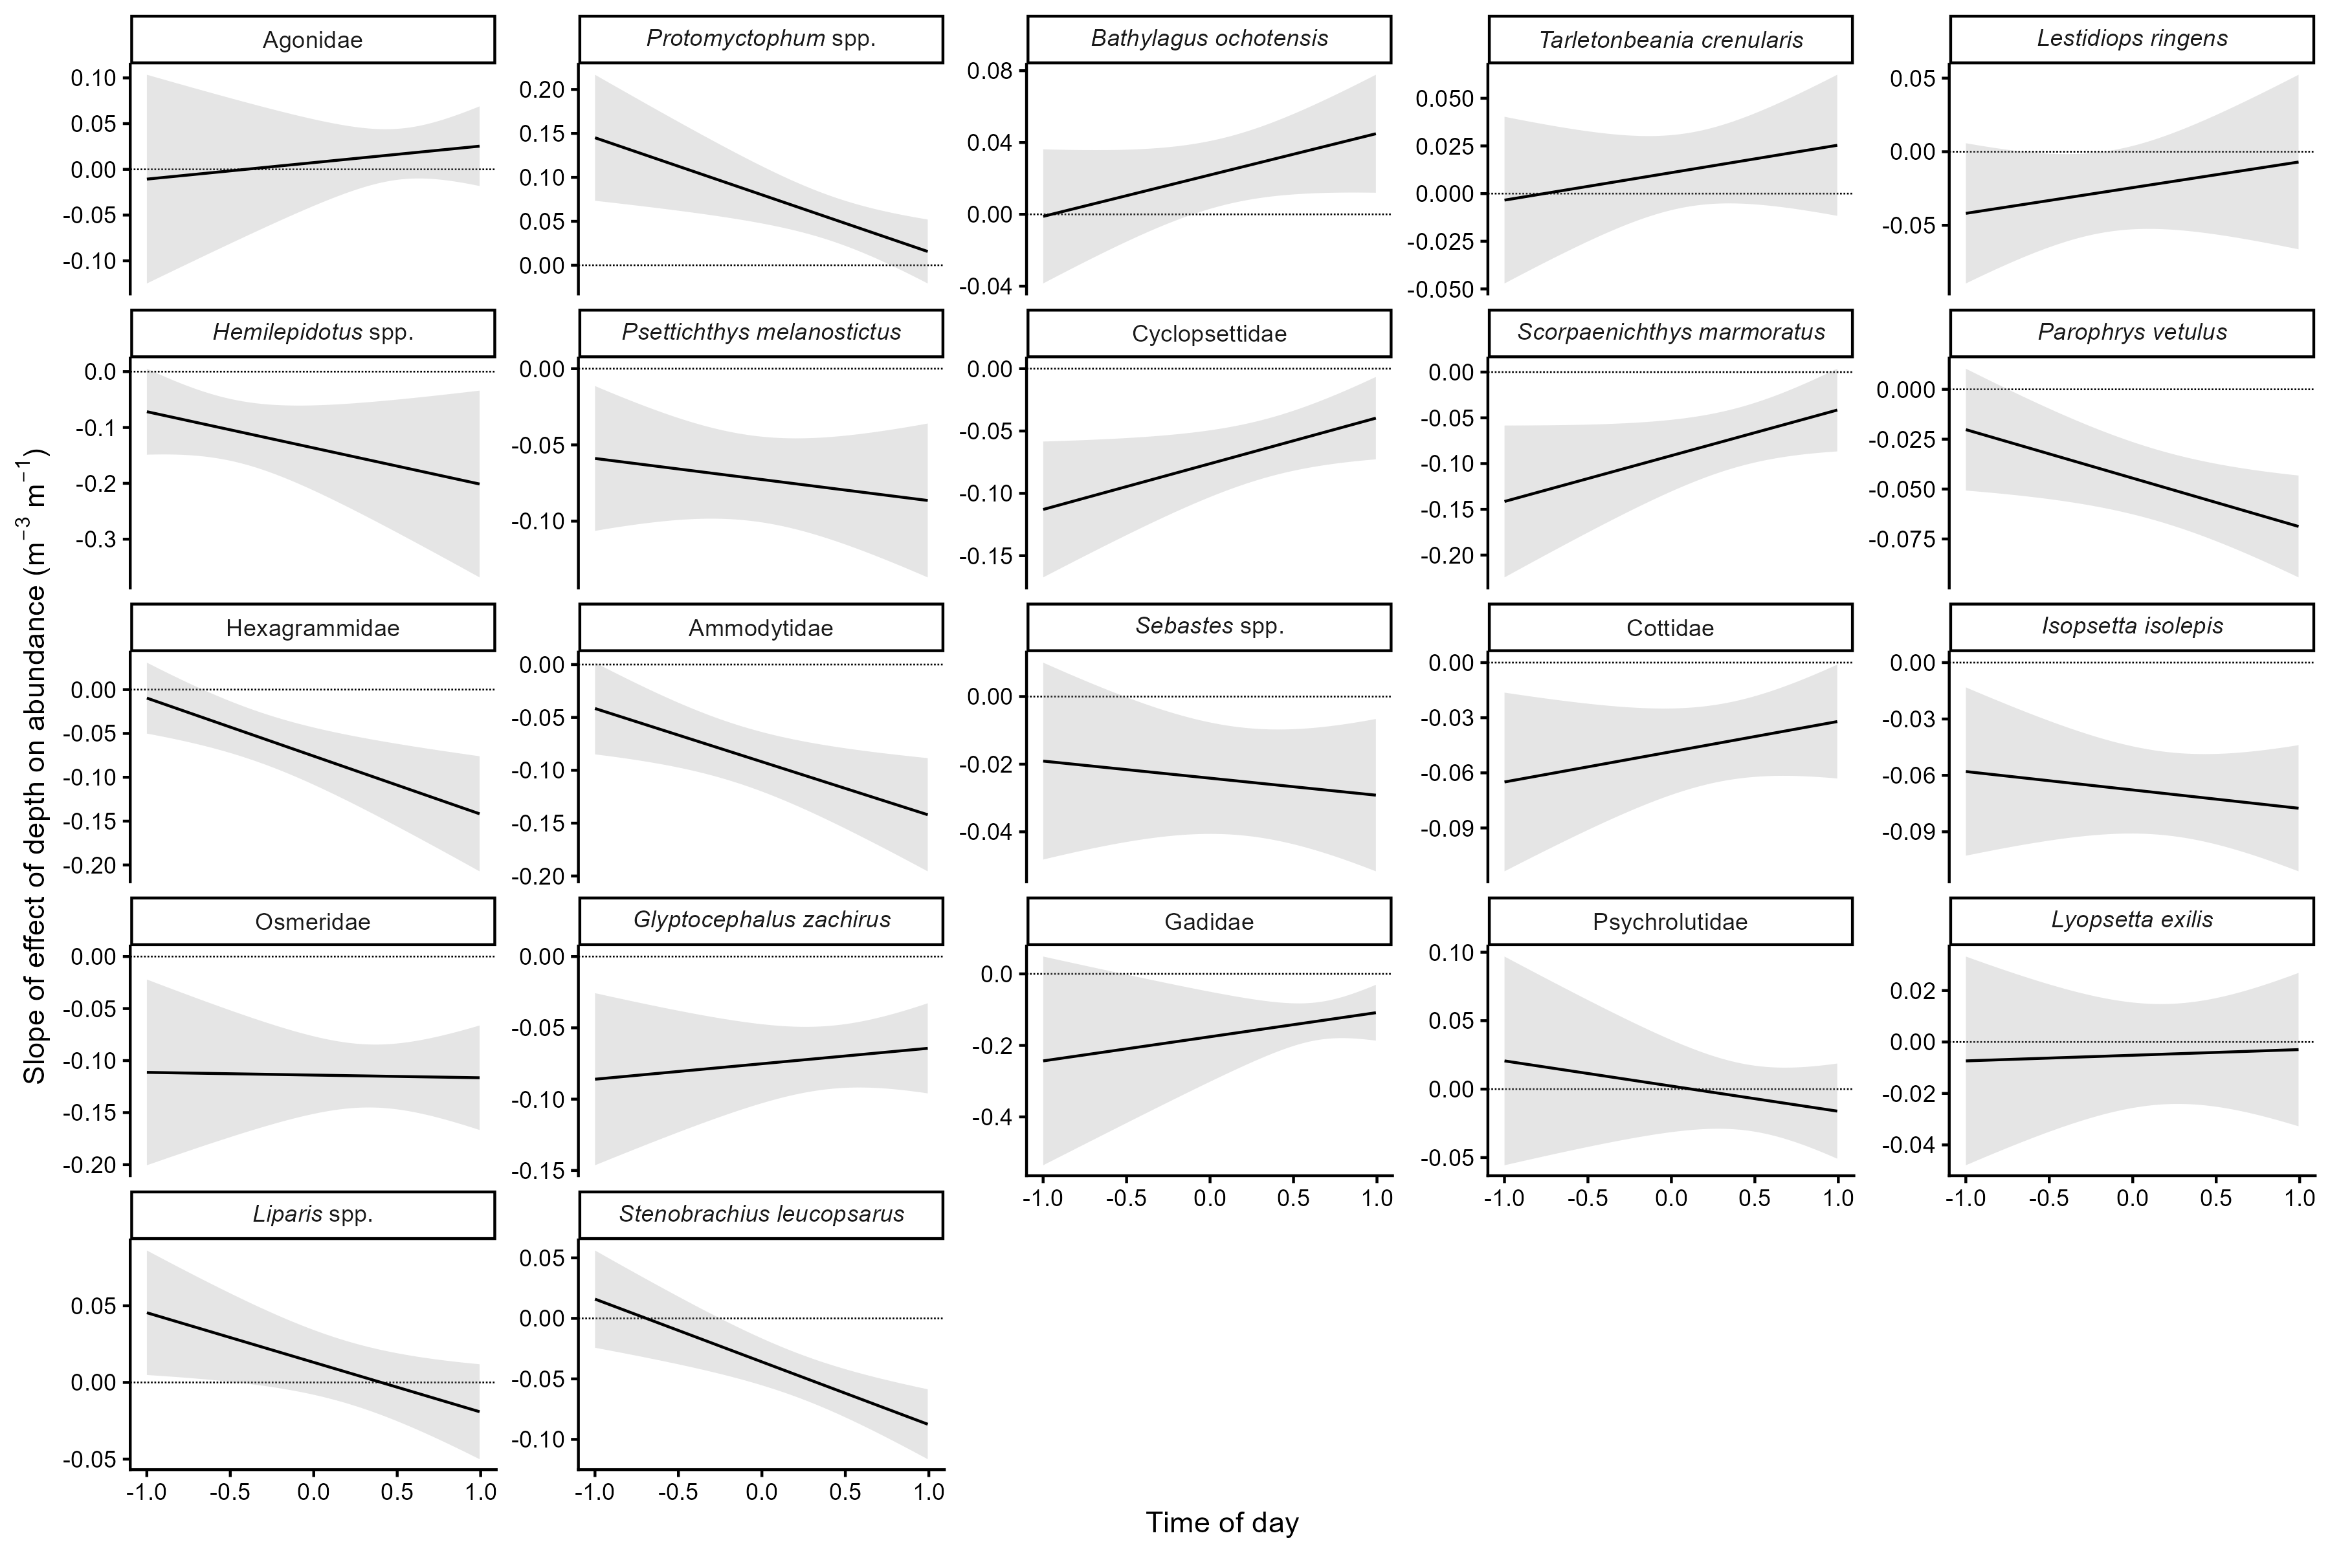
Fig. 8. Taxon-specific relationships between the slope of the effect of depth on abundance and time of day predicted from GLMM.

Slide 13
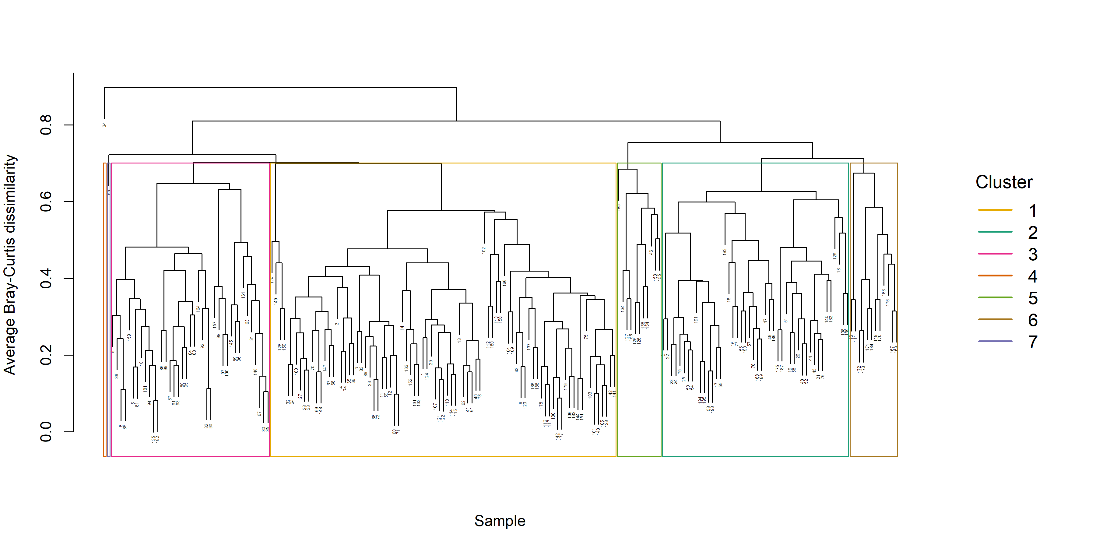
Fig. S1. Dendrogram

Slide 14
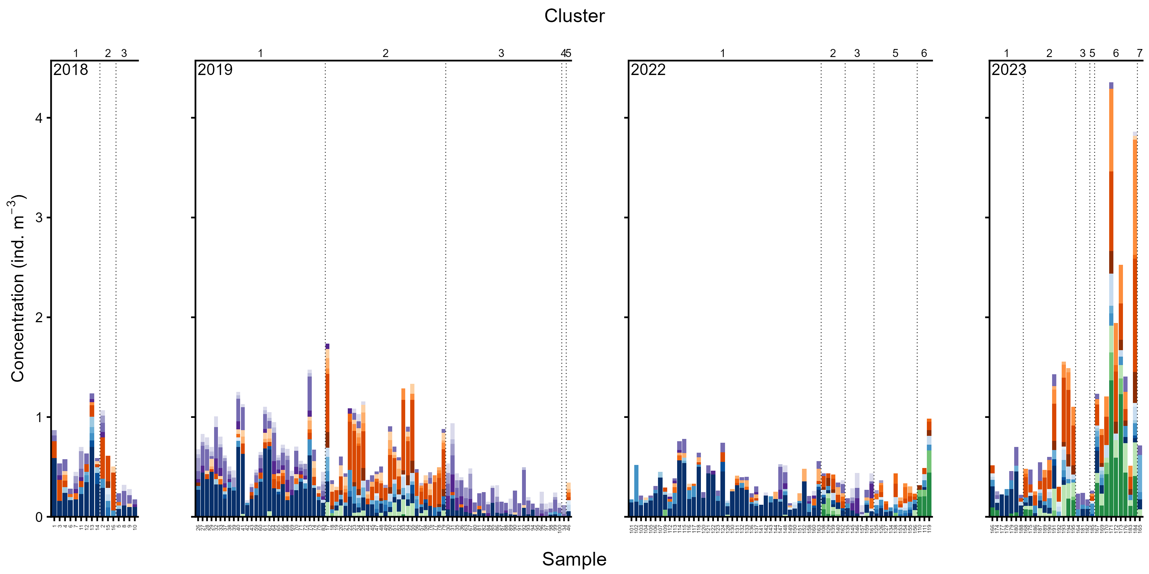
Fig. S2. Concentration of taxa in samples assigned to each cluster in each year.

Slide 15
Table S1. Model parameters from vertical position GLMM?

